Slide 1
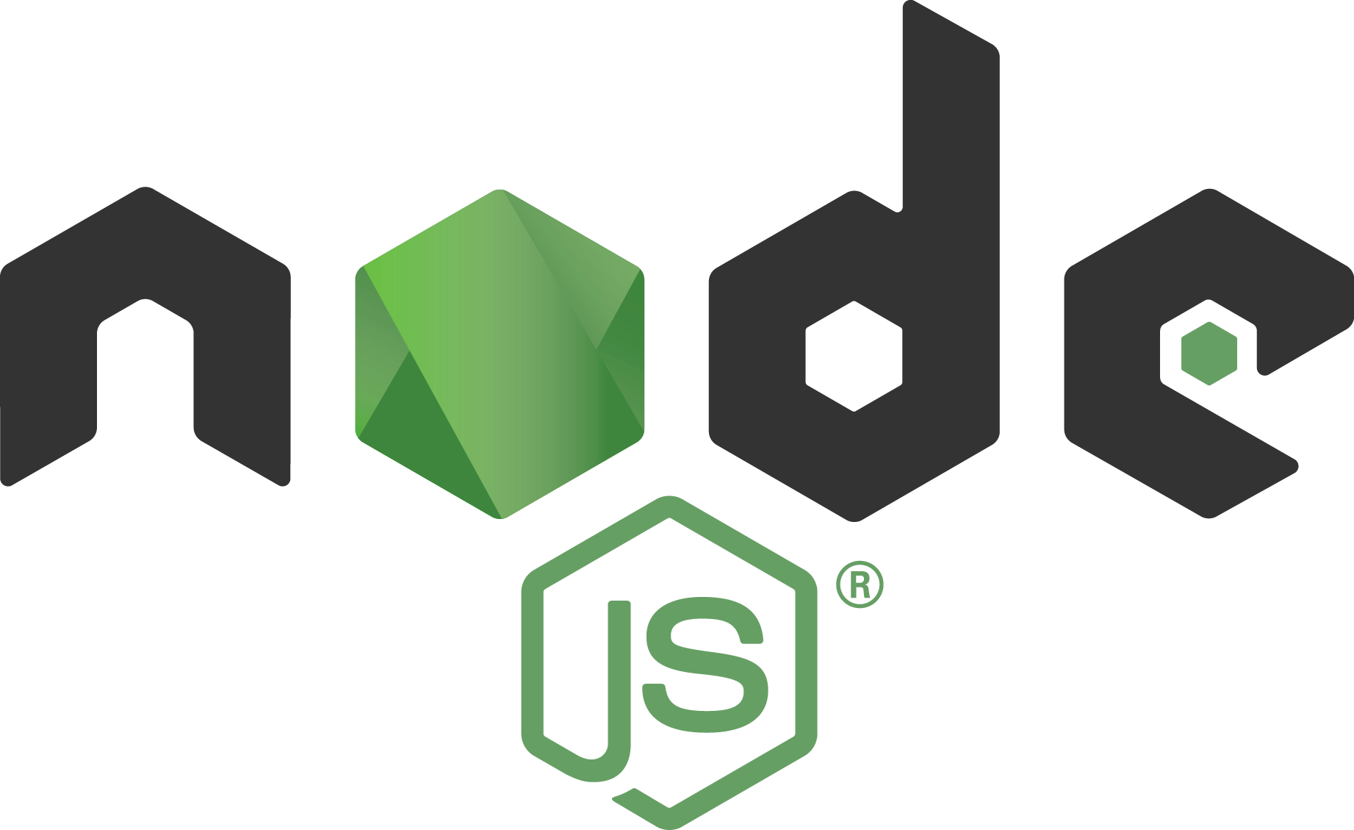

Web Programming
MEAN
(MongoDB, Express.js, Angular and Node.js)

Slide 2
Overview
MEAN
Node.js
Node.js modules
Node.js packages
Express Framework
MongoDB
MongoDB CRUD operations

Slide 3
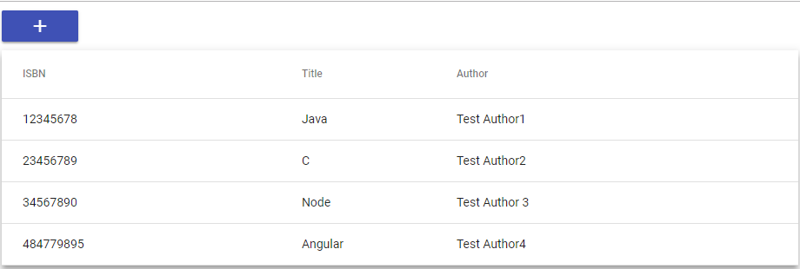
Use Case-Library Management System
View books:

Slide 4
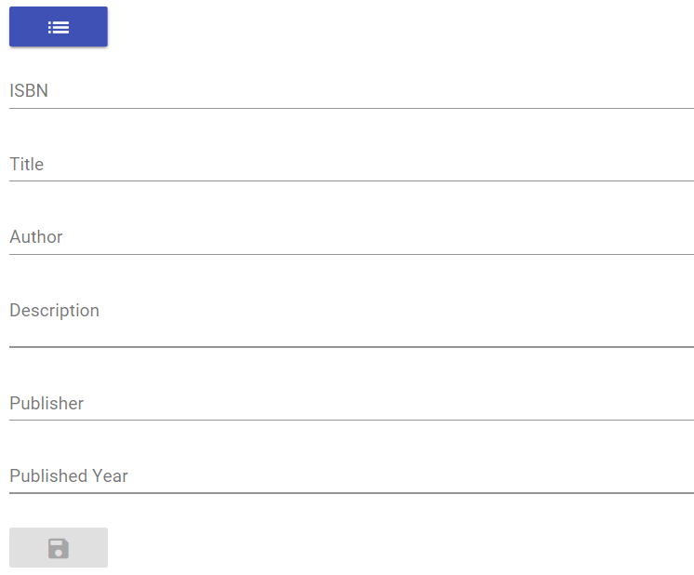
Add a new book:

Slide 5
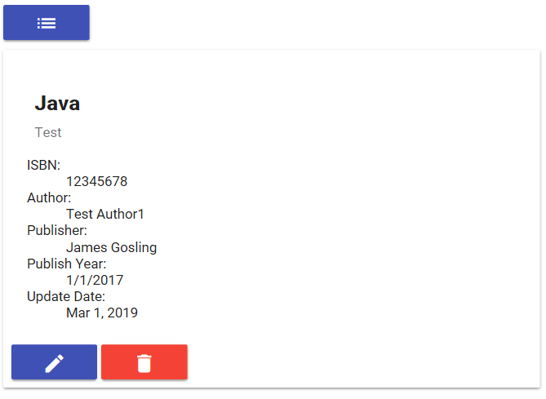
View book details:

Slide 6
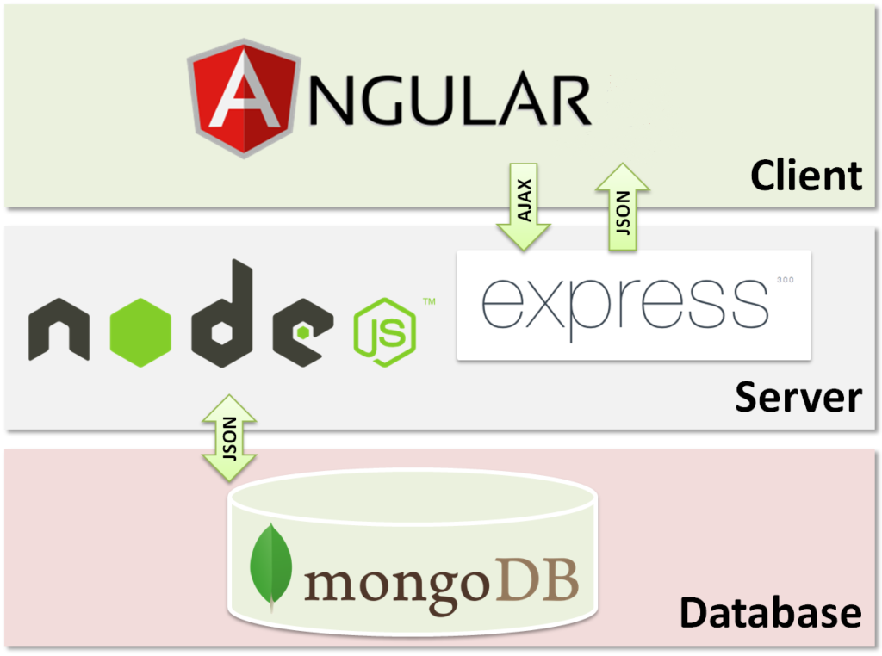
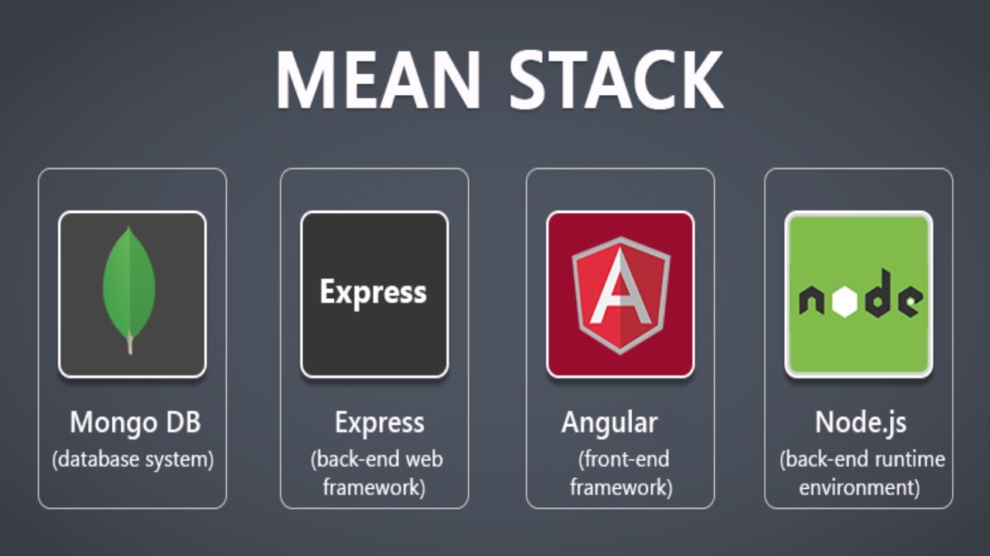
What Is MEAN
MEAN is a web development solution completely based on full stack JavaScript
The name is an acronym, standing for MongoDB, Express, Angular, and Node.js

Slide 7
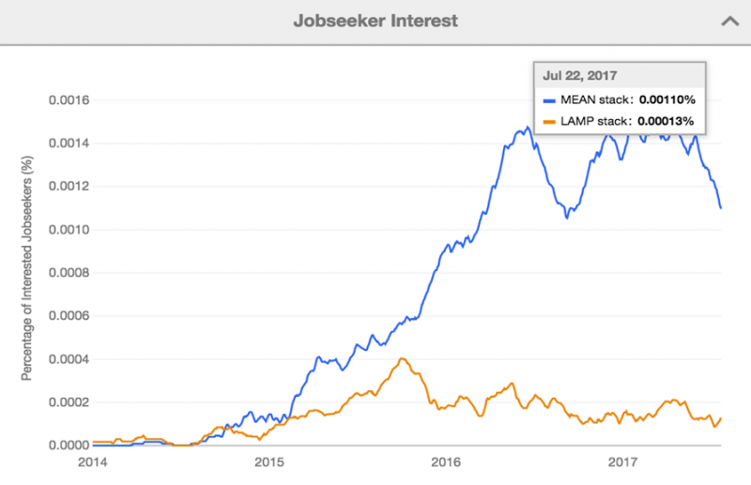
Why MEAN
Source – indeed.com

Slide 8
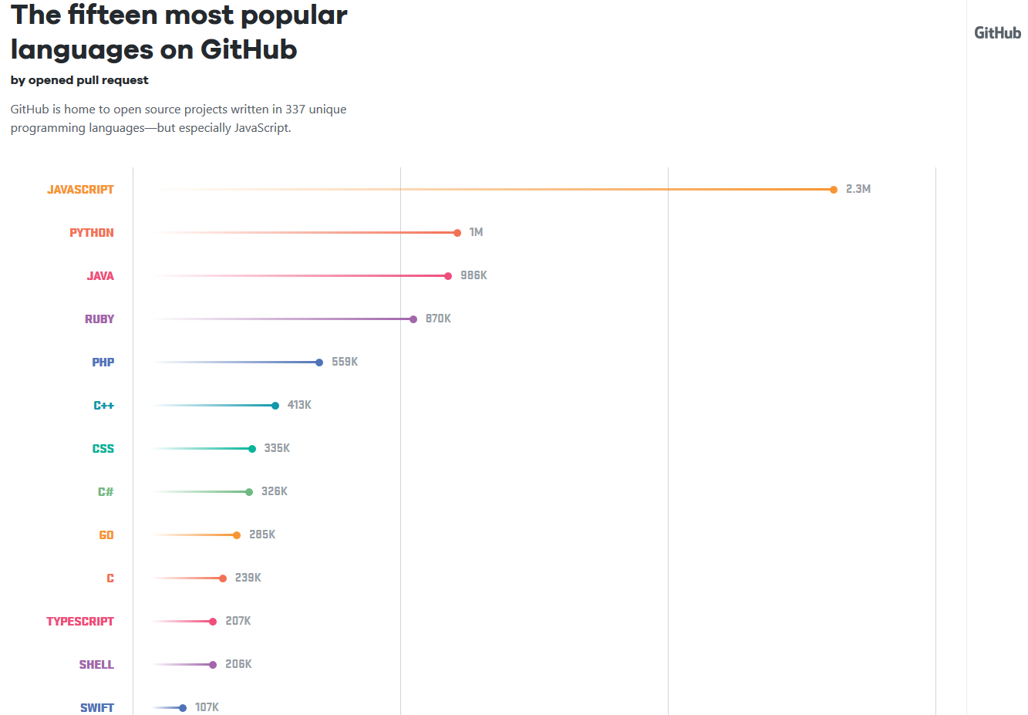
Why MEAN
2017 GitHub survey
Source – https://octoverse.github.com/2017/

Slide 9
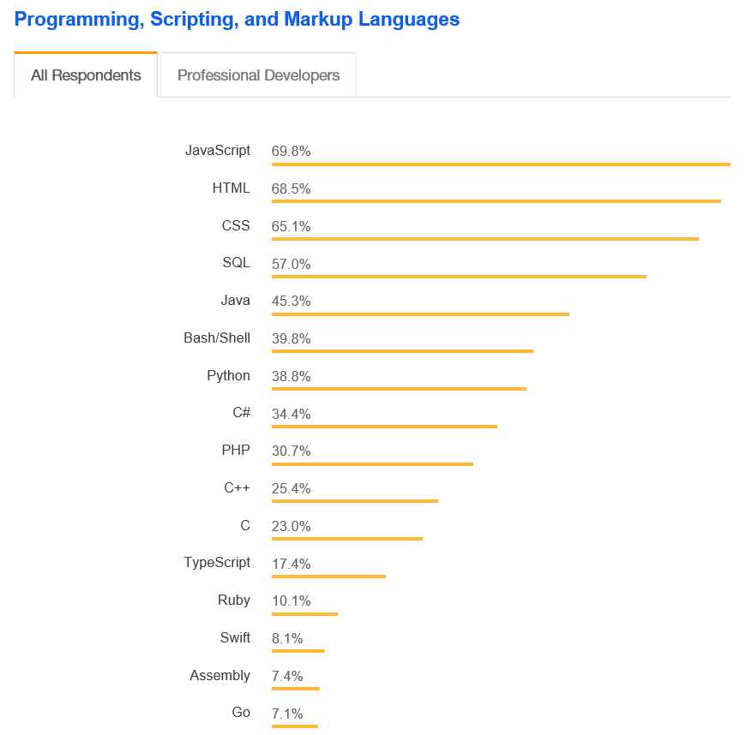
Why MEAN
2018 Stack Overflow survey
Source – https://dzone.com/articles/5-reasons-to-choose-meanjs-stack-when-building-you

Slide 10
What is Node.js?
Created 2009
Evented I/O for JavaScript
Server-Side JavaScript
Runs on Google's V8 JavaScript Engine

Slide 11
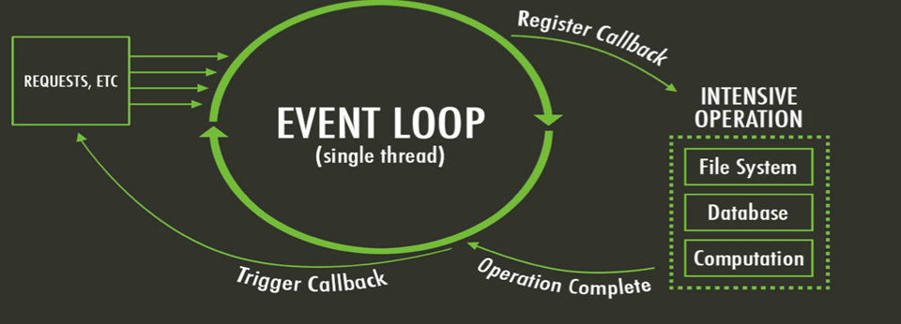
Evented I/O for JavaScript
Servers normally thread based but Node.js is "Event" based
Node.js serves each request in an Evented loop that can handle simultaneous requests

Slide 12
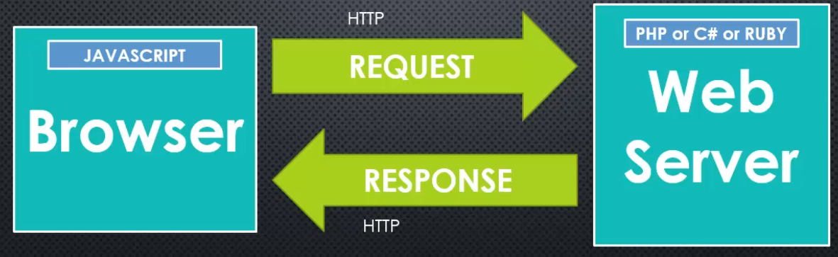
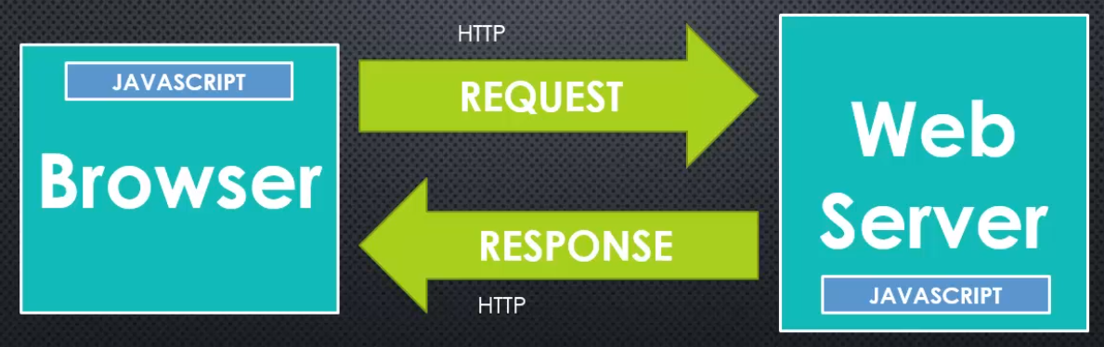
Server-Side JavaScript
Without Node
With Node
Notes:
JavaScript on server-side thus making communication between client and server will happen in same language

Slide 13
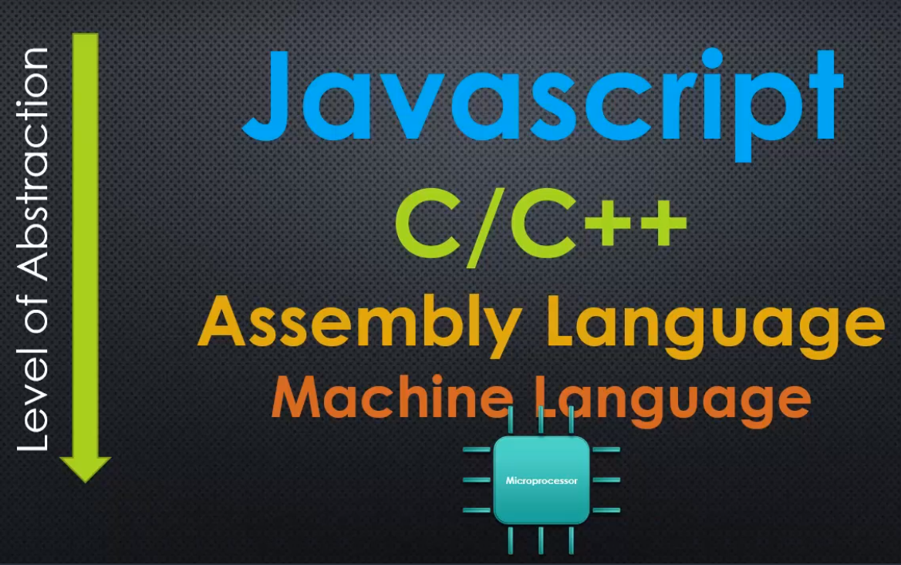
Google's V8 JavaScript Engine
Source: https://github.com/nodejs/node
Notes:
By compiling the JavaScript source code to native machine code before the execution, it allows for building scalable and performant web apps.
V8 the thing that converts JavaScript to machine code, is written in C++.
Node is written in C++.
when I'm trying to learn Node JS, is about JavaScript.
When I'm writing Node, I'm writing JavaScript.
We write in JavaScript when we write Node programming
but Node itself, is written in C++,
And the reason why Node is a C++ programming, is written in that programming language, is because V8 the JavaScript engine is written in C++.
V8 the thing that converts JavaScript to machine code, is written in C++.
And so Node, which adds onto it, is also written in C++.

Slide 14
Why Node.js?
Asynchronous and Event Driven
non – blocking calls & use of callbacks
Very Fast
built on Google Chrome's V8 JavaScript Engine
Single threaded
event looping
Highly Scalable
provides service to a larger number of requests than traditional servers like Apache HTTP Server
No Buffering
outputs the data in chunks

Slide 15
Why Node.js use event-based?
Normal webserver while processing the request will have to wait for the IO operations and thus blocking the next request to be processed
Node.js process each request as events, doesn't wait (non-blocking) for the IO operation to complete
It can handle other request at the same time
When the IO operation of first request is completed it will call-back the server to complete the request

Slide 16
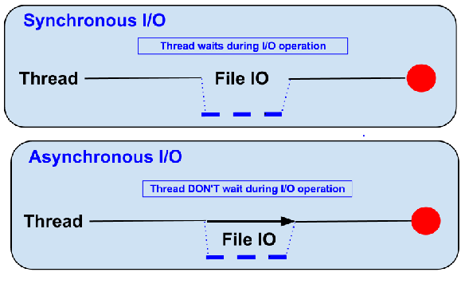
Blocking vs Non-Blocking
Example: Read data from file and show data

Slide 17
Blocking
Read data from file
Show data
Do other tasks
var data = fs.readFileSync("test.txt");
console.log(data);
console.log("Do other tasks");

Slide 18
Non-Blocking
Callback
Read data from file
When read data completed, show data
Do other tasks
fs.readFile("test.txt", function(err, data) {
console.log(data);
});

Slide 19
What Can Node.js Do?
Node.js can generate dynamic page content
Node.js can create, open, read from, write to, delete, and close files on the server
Node.js can collect form data
Node.js can add, delete, modify data in your database

Slide 20
Where to Use Node.js?
I/O bound Applications
Data Streaming Applications
Data Intensive Real-time Applications (DIRT)
JSON APIs based Applications
Single Page Applications

Slide 21
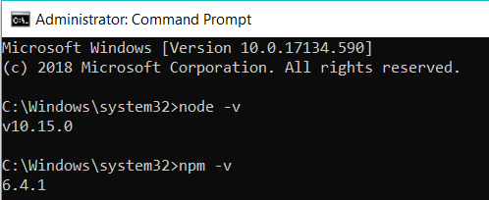
Node.js Installation
Install Node JS from https://nodejs.org/en/
Refer the Installation PPT
Check the installation with following commands
>node –v
>npm –v

Slide 22
Start with Node.js
Three Components of Node.js :
Import required Modules (to load necessary modules)
Create Server (to handle client's requests similar to Apache HTTP Server)
Read request and return response (request comes from browser and response returns to same browser)
Running the Node.js application from command prompt
> node <name_of_js_file (example.js)>

Slide 23
Node.js Modules
Node.js Module is a set of functions you want to include in your application
Node.js has a set of built-in modules which you can use without any further installation
Users can create their own modules
To include a module, use the require() function with the name of the module:
Syntax: var http = require(‘<required module>');

Slide 24
A Few built-in Modules
HTTP Module
URL Module
Events Module
File System Module

Slide 25
Hello World example
Create file index.js with the following code:
http.createServer(function (request, response) {
// Send the HTTP header
// HTTP Status: 200 : OK
// Content Type: text/plain
response.writeHead(200, {'Content-Type': 'text/plain'});
// Send the response body as "Hello World"
response.end('Hello World\n'); }).listen(8080);
// Console will print the message
console.log('Server running at http://127.0.0.1:8080/');

Slide 26
HTTP Module
Allows Node.js to transfer data over the Hyper Text Transfer Protocol (HTTP)
The HTTP module can create a HTTP server that listens at server ports and gives a response back to the client

Slide 27
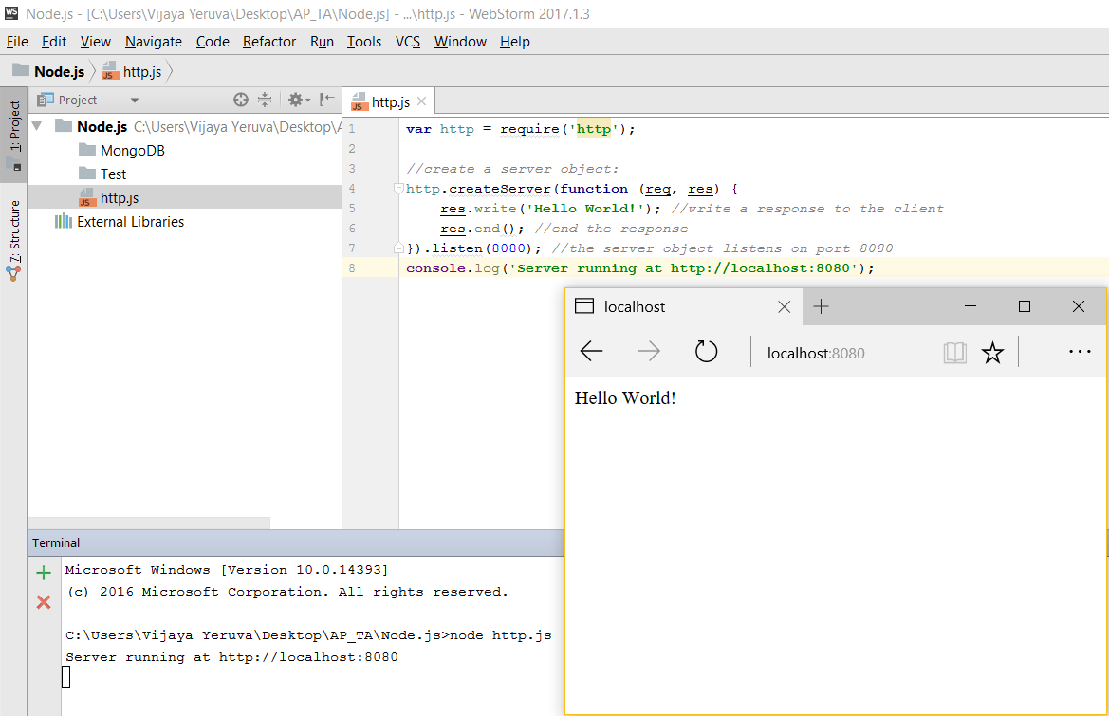
HTTP Module

Slide 28
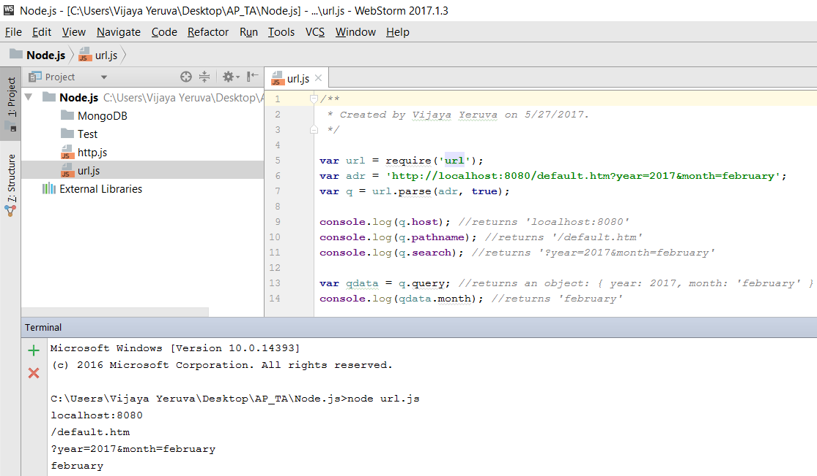
URL Module
Splits up a web address into readable parts

Slide 29
Events Module
create, fire, and listen for your own events
In addition, all event properties and methods are an instance of an EventEmitter object
To be able to access these properties and methods, create an EventEmitter object
When the EventEmitter object emits an event, all the functions attached to that specific event are called synchronously
Any values returned by the called listeners are ignored and will be discarded

Slide 30
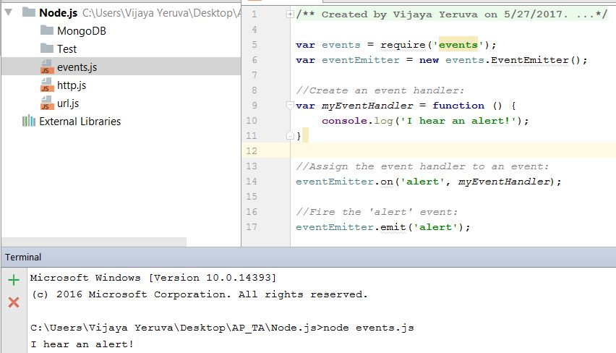
Events Module

Slide 31
File System Module
The Node.js file system module allow you to work with the file system on your computer
Common use for the File System module:
Read files
Create files
Update files
Delete files

Slide 32
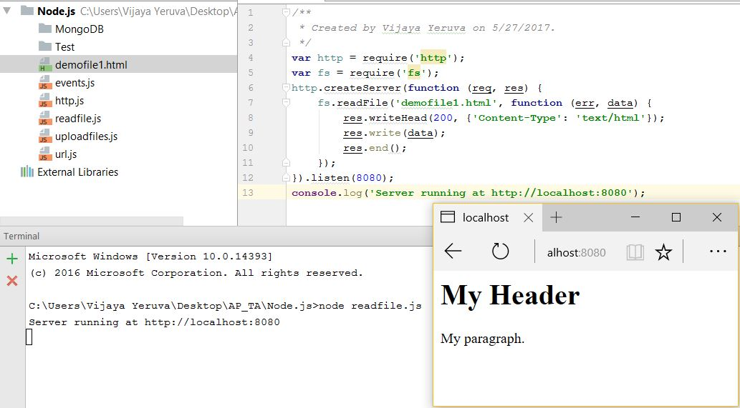
File System Module

Slide 33
Node.js Packages and Package Managers
Package: CODE
And it's managed and maintained with a package management system
Package Management System: It is a software that automates installing and updating packages
It deals with what versions you have or need, and manages dependencies

Slide 34
NPM
NPM is a package manager for Node.js modules
www.npmjs.com hosts thousands of free packages to download and use
NPM makes it easy for JavaScript developers to share and reuse code, and it makes it easy to update the code that you're sharing
The NPM program is installed on your computer when you install Node.js

Slide 35
Download the NPM Package
To download particular package
<your project location>>npm install <package name>
E.g.: C:\Users\Vijaya\WebLesson6>npm install upper-case
To download all available packages
<your project location>>npm install
E.g.: C:\Users\Vijaya\WebLesson6>npm install

Slide 36
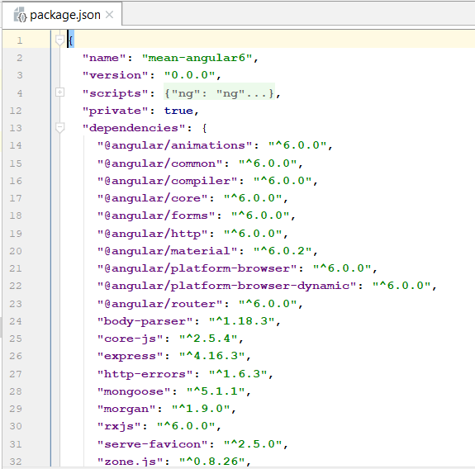
package.json
Project information
Name
Version
Dependencies
Licence
Main file
Etc...

Slide 37
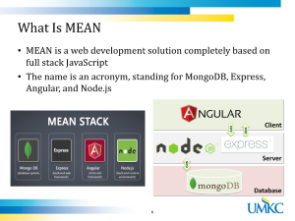
Express Framework
Minimal and flexible Node.js web application framework for web and mobile apps
Allows to set up middlewares to respond to HTTP requests
Defines routing using actions and URLs
Dynamically renders HTML pages based on passing arguments

Slide 38
Express gives ease of functionality
Routing
Delivery of Static Files
“Middleware” – some ease in development (functionality)
Form Processing
Simple forms of Authentication
Cookies and Session Manipulation
A lot of this you can do in Node.js but, you may write more code to do it than if you use the framework Express.

Slide 39
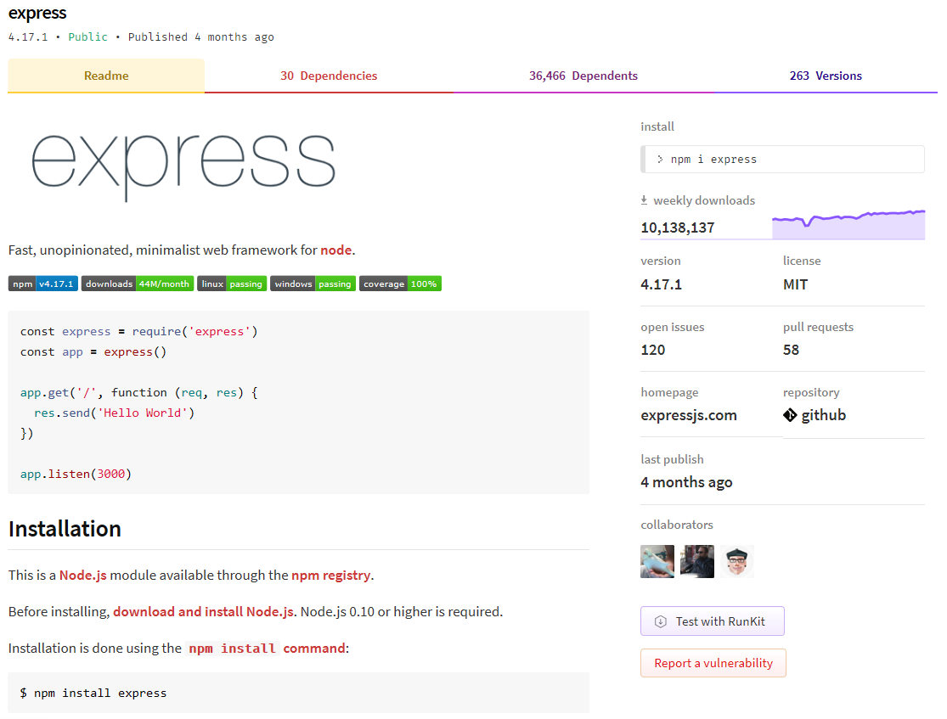
Express Framework
Source: https://expressjs.com/

Slide 40
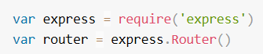
Routes and Middleware
Routing refers to how an application's endpoints (URIs) respond to client requests
Use the express.Router class to create modular, mountable route handlers
A Router instance is a complete middleware and routing system; for this reason, it is often referred to as a "mini-app"
Source: https://expressjs.com/en/guide/routing.html

Slide 41
Express – hello world code
app.js have the code
var express = require('express')
var app = express()
app.get('/', function (req, res) {
res.send('Hello World!')
})
app.listen(3000, function () {
console.log('Example app listening on port 3000!')
})
This says requires module express
Calls function express to initialize object app
App object has various methods like get that responds to HTTP get request.
This code will call the function specified when a GET for the URI ‘/’ is invoked
Sets up the HTTP server for listening port 3000

Slide 42
Introduction to MongoDB
MongoDB is an open source NoSQL database using a document-oriented data model
This means it relies on the architecture consisting of collections and documents instead of tables and rows (as in relational databases)
This database is extremely scalable and can handle large volumes of data
MongoDB documents are similar to JSON objects

Slide 43
MongoDB with NodeJS
Node.js can be used in database applications
MongoDB can be accessed in local machine
MongoDB can be accessed in cloud through Mongo Lab
Local: Install MongoDB in local https://www.mongodb.com/
Cloud: Create an account in Mongo Lab
Refer the installation PPT
To download MongoDB package: npm install mongodb
Node.js can use this module to manipulate MongoDB databases
Source: https://docs.mongodb.com/

Slide 44
MongoDB CRUD Operations
Create Operations
Read Operations
Update Operations
Delete Operations
Source: https://docs.mongodb.com/

Slide 45
Start the MongoDB Server
Command: mongod --dbpath "path where to initiate DB"
E.g.: mongod --dbpath "C:\Users\Vijaya\Desktop\AP_Web\NodeJS\MongoDB"
To create a database in MongoDB, start by creating a MongoClient object, then specify a connection URL with the correct IP address and the name of the database you want to create
MongoDB will create the database if it does not exist, and make a connection to it
Source: https://docs.mongodb.com/

Slide 46
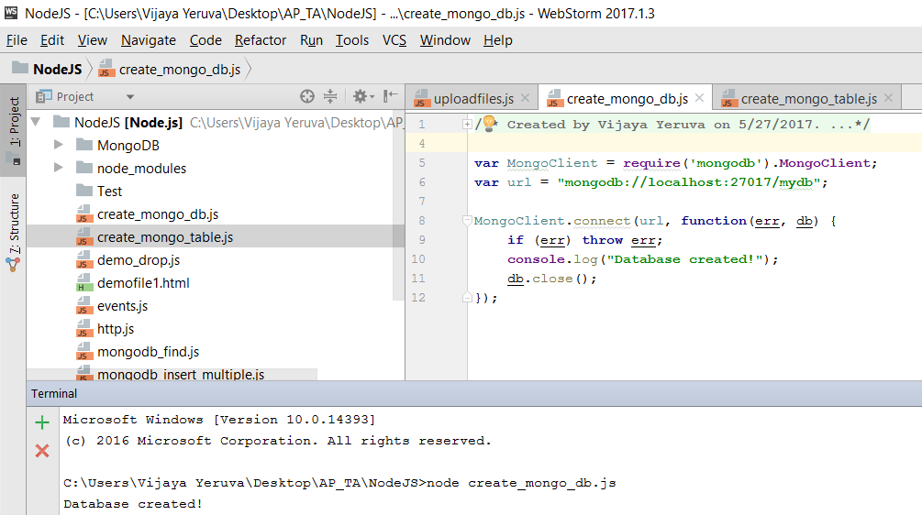
Create the Database
Source: https://docs.mongodb.com/

Slide 47
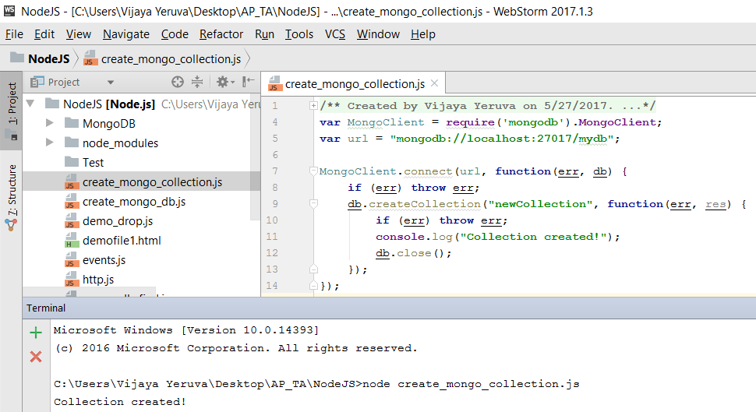
Create the Collection
Source: https://docs.mongodb.com/

Slide 48
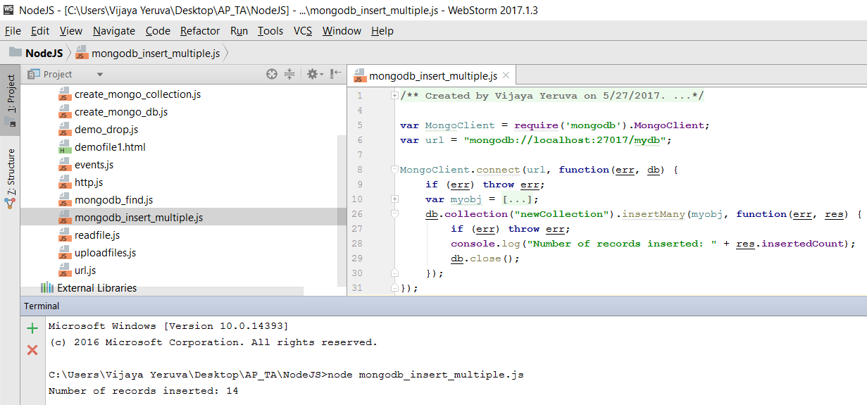
Create Operations
Source: https://docs.mongodb.com/

Slide 49
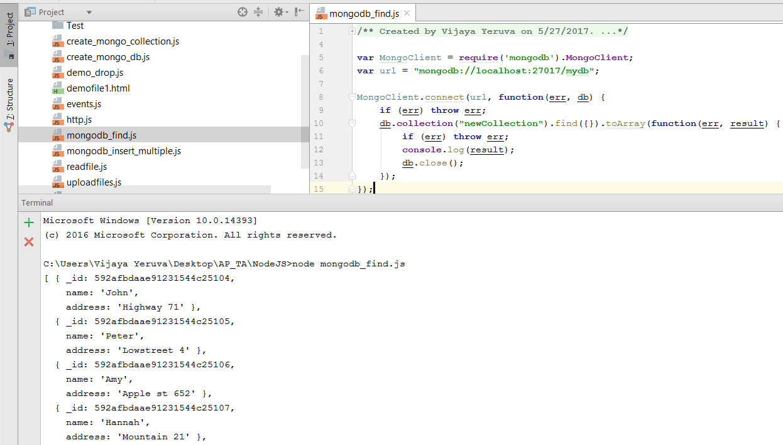
Read Operations
Source: https://docs.mongodb.com/

Slide 50
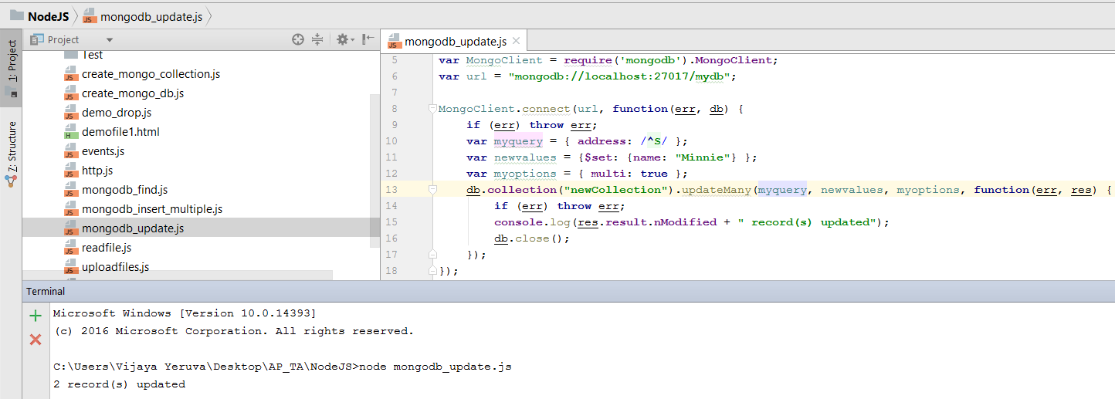
Update Operations
Source: https://docs.mongodb.com/

Slide 51
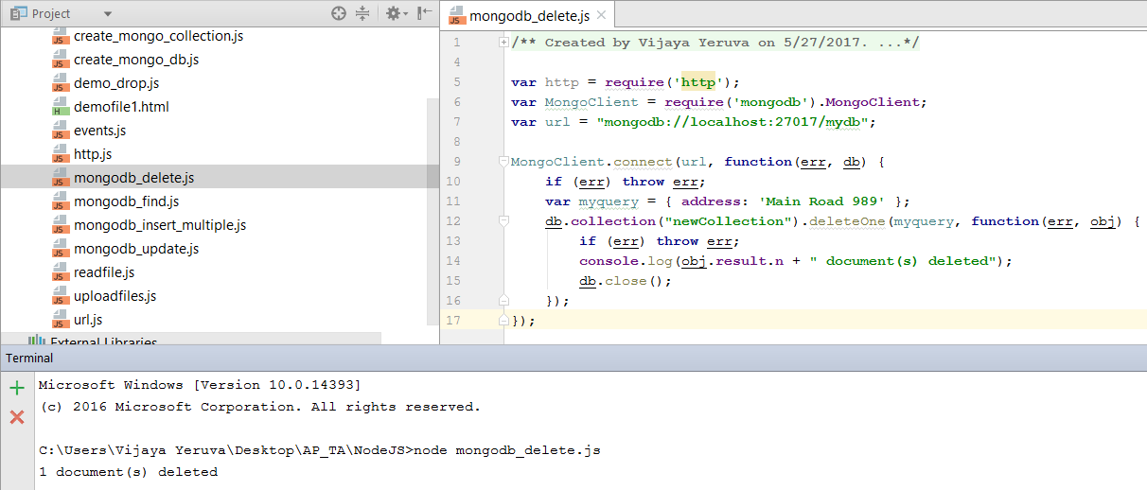
Delete Operations
Source: https://docs.mongodb.com/

Slide 52
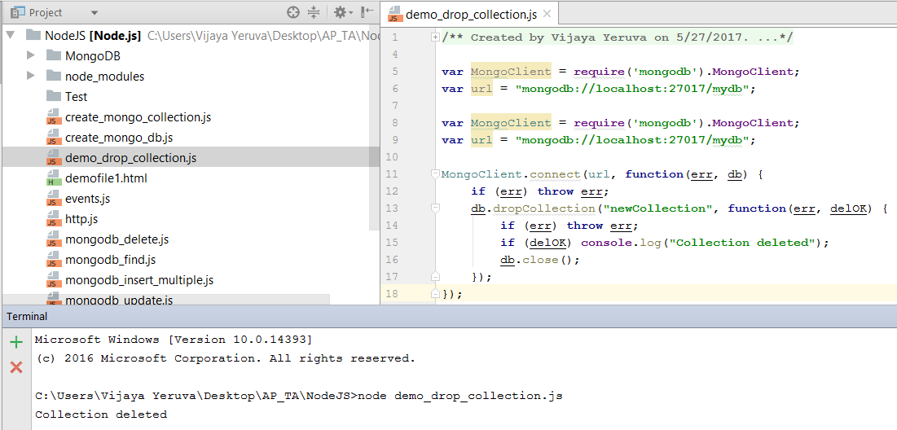
Drop the Collection
Source: https://docs.mongodb.com/

Slide 53
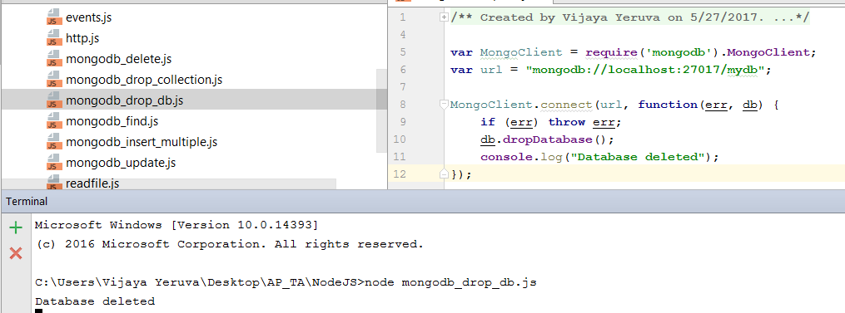
Drop the Database
Source: https://docs.mongodb.com/

Slide 54
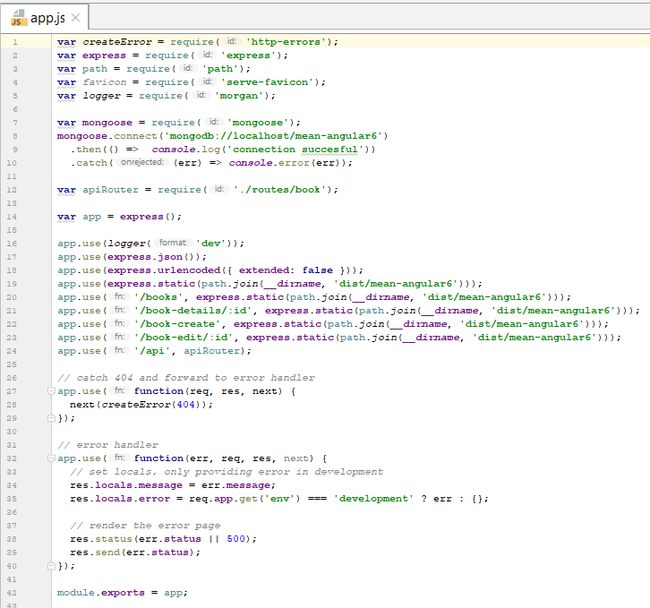
Use Case
App Server

Slide 55
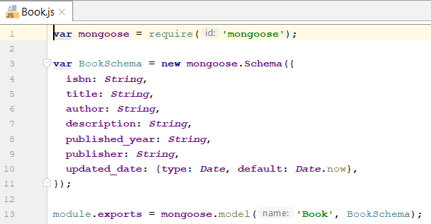
Mongoose Model

Slide 56
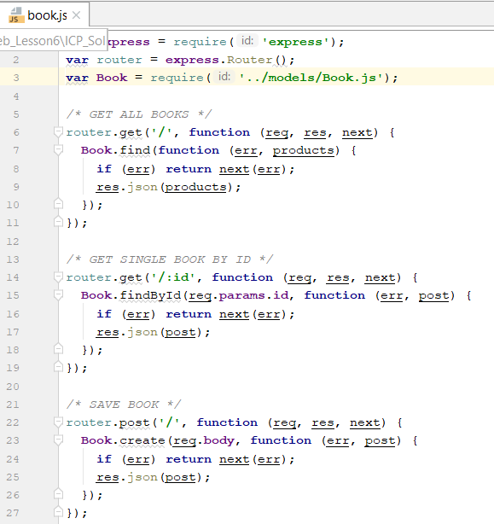
Routes for Accessing Book Data via Restful API

Slide 57
ICP
Please refer steps in the lesson plan

Slide 58
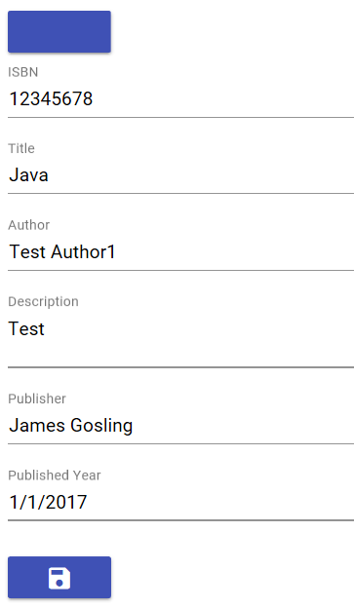
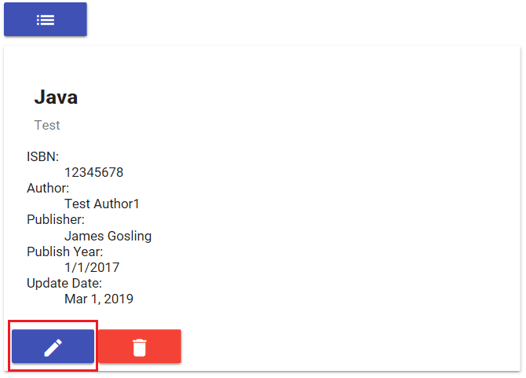
Update book details:

Slide 59
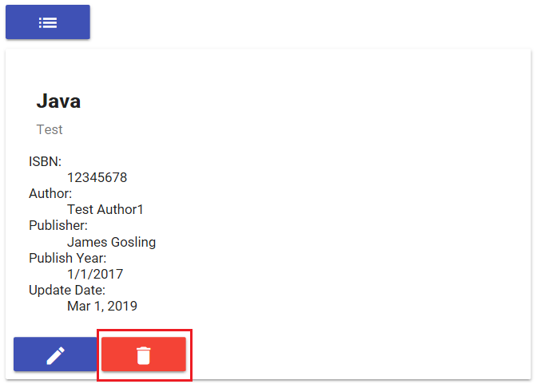
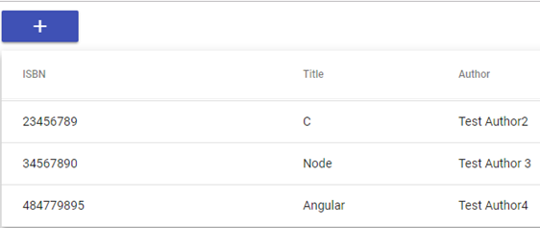
Delete book details:

Slide 60
References
https://www.w3schools.com/nodejs/default.asp
https://nodejs.org/en/
https://nodeschool.io/
https://www.tutorialspoint.com/nodejs/nodejs_introduction.htm
https://www.mongodb.com/
https://www.youtube.com/watch?v=0vPt7GI-2kc

